Slide 1
Lesson 7-4
Simplifying Radicals

Slide 2
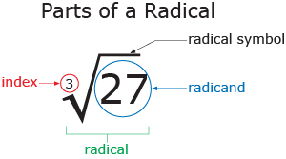
What are Radicals?
The Radical symbol , used to indicate a root, it can square root or a cube root depending on the index number. Square roots has an index number of 2, and the cube root has an index number of 3
A SQUARE ROOT RADICAL IS SIMPLIFIED, or in its simplest form, when the radicand has no square factors.

Slide 3
Example 1:
33 has no square factors.
Its factors are 3• 11
neither of which is a square number
its simplest form.

Slide 4
Example 2.
$$(2)$$
$$9$$
18 has the square factor 9.
18 = 9 • 2.
It is not in its simplest form.
Extract, or take out, the square root of 9 from the radical
Irrational number is left next to the largest perfect square
$$18$$
$$\sqrt{2}$$
$$3$$

Slide 5
Example 3:
$$25$$
$$(3)$$
75
$$\sqrt{3}$$
$$5$$

